Slide 1


Electronic Visit Verification (EVV) and How to Use it
Notes:
Good morning everyone and welcome to Consumer Direct Care Network’s training session regarding EVV. My name is Janelle Herbert and I am the Outreach Coordinator with CDCN. During this training, we will be focusing on EVV, and how to use the CDCN EVV compliant systems. If you have any questions, you can put them in the chat at any time and a CDCN rep will answer them for you. We have also posted some frequently asked questions in the chat as well for your review. Please do not put any personal or case specific information in the chat. For assistance pertaining to a specific situation, please call or email us directly. Today we will have an overview of what EVV is, who is affected by it, and how to use EVV compliant systems.

Slide 2

EVV Is a Federal Requirement
All attendants are required to use CareAttend or IVR when submitting time.
2
Notes:
EVV stands for Electronic Visit Verification. This is a digital timekeeping system used to keep track of the hours worked and services provided by an attendant to a member participating in the Medicaid consumer directed model of care. Effective October 1, 2026, ALL attendants participating in the consumer directed model of care, regardless of their live-in status, will be required to submit their work shifts using a platform that has been identified as EVV compliant. Live-in attendants will NO LONGER be exempt from using EVV compliant systems to submit their work shifts and will no longer be allowed to submit their work shifts through the CDCN web portal. This is a federal requirement mandated by the federal government and not something Consumer Direct Care Network is putting into place. CDCN utilizes the CareAttend app as one of their EVV compliant platforms to manage all attendants’ work shifts.
*Pause for questions*

Slide 3



How to Download CareAttend
  Go to the App Store (iOS/iPhone) or Google Play Store (Android)
  Search for CareAttend
iOS/iPhone
Android
3
Notes:
The Care Attend app can be downloaded to any smart device, but it does have to be a smart device! This means the device must have internet access and the ability to download applications. The app can be found in which ever app store your smart device utilizes. Please note, that when searching for the CareAttend app in the app store, CareAttend is spelled as one word. A video on how to download the CareAttend app can be found on the CDCN website at www.consumerdirectva.com under the Training menu.

Slide 4
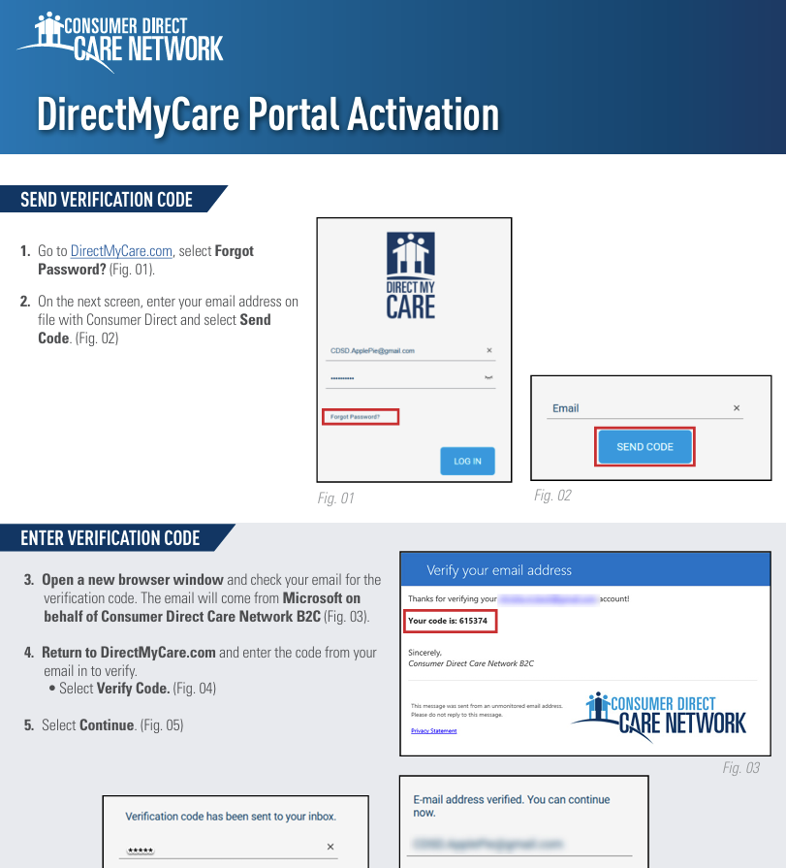
How to Activate the Web Portal
https://vimeo.com/911718657
Notes:
Now I’m going show you a few training videos that will show you how to use our EVV compliant platforms for time entry. These videos are also available on the CDCN website at www.consumerdirectcare.com under the Training menu. The first one will show you how to activate your CDCN web portal. Please note, that you will need to activate the web portal BEFORE you are able to log into the CareAttend app for the first time.
*Show video* REMEMBER TO SHARE SOUND!
Written instructions on how to activate your web portal are also available on the CDCN website.

Slide 5
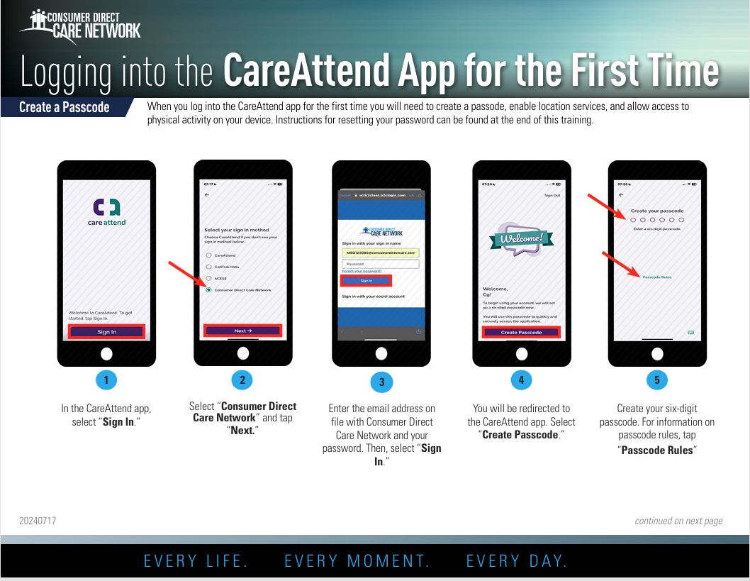
How to Log Into CareAttend
https://vimeo.com/1009331740
Notes:
This video will show you how to log into CareAttend for the first time.
*Show video*
These written instructions are also available on the CDCN website.

Slide 6
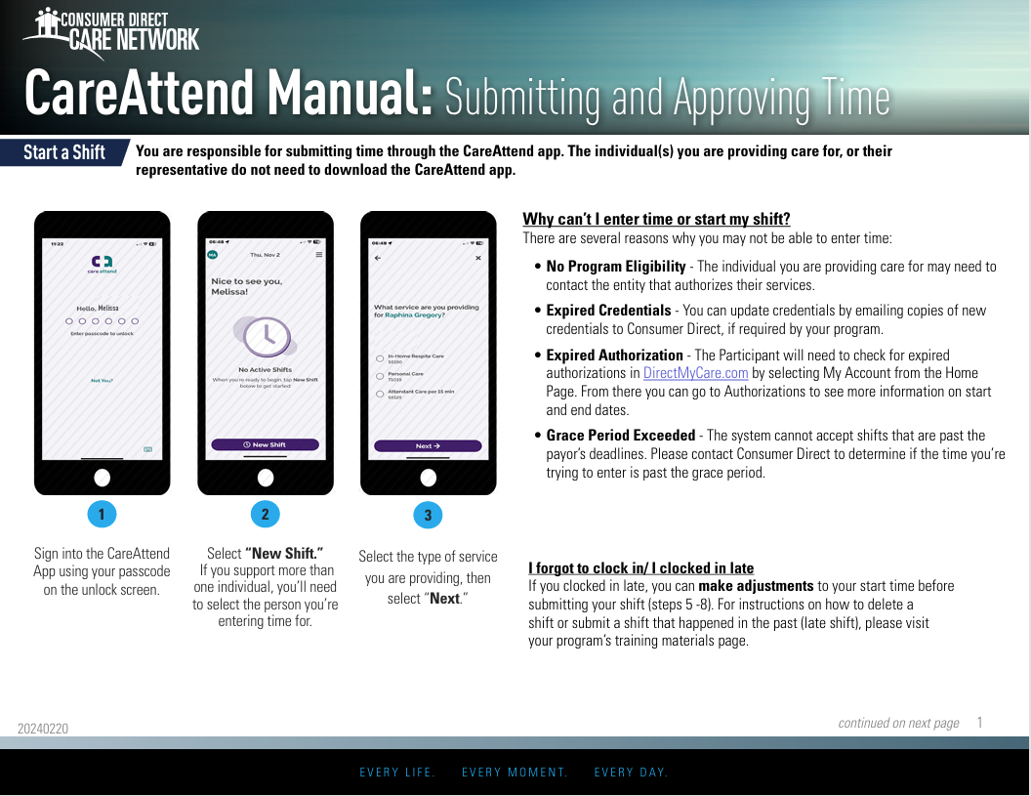
How to Start and Stop a Shift in CareAttend
https://vimeo.com/1009331766
Notes:
The next video will show you how to start and stop a shift in the CareAttend app.
*Show video*
Written instructions on how to start and stop a shift are also available on the CDCN website under the training menu.

Slide 7
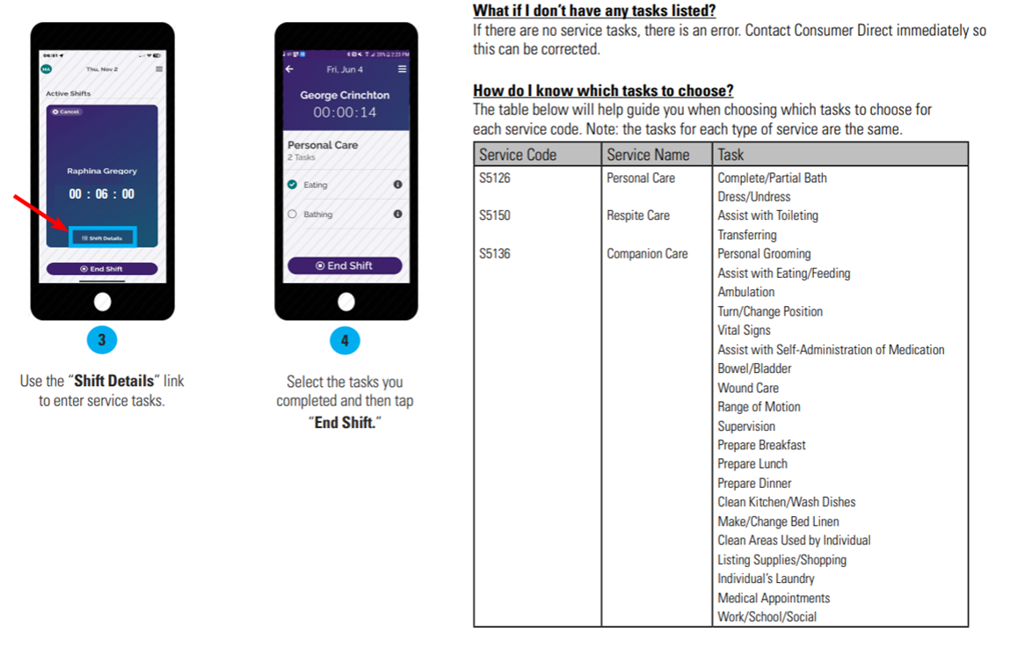
How to Add Tasks
7
Notes:
The CareAttend app allows the attendant to input the various tasks that were performed for the member during the attendant’s work shift. This too is a mandate implemented by the federal government. If tasks are not selected, the app will not allow the attendant to submit their time in the CareAttend app. The training video only showed a few tasks to select as options. Here is a full list of all the tasks that will be available for selection in the live application. Please be sure to only select tasks that are permitted to be performed during the attendant’s work shift.
*Pause for questions*

Slide 8
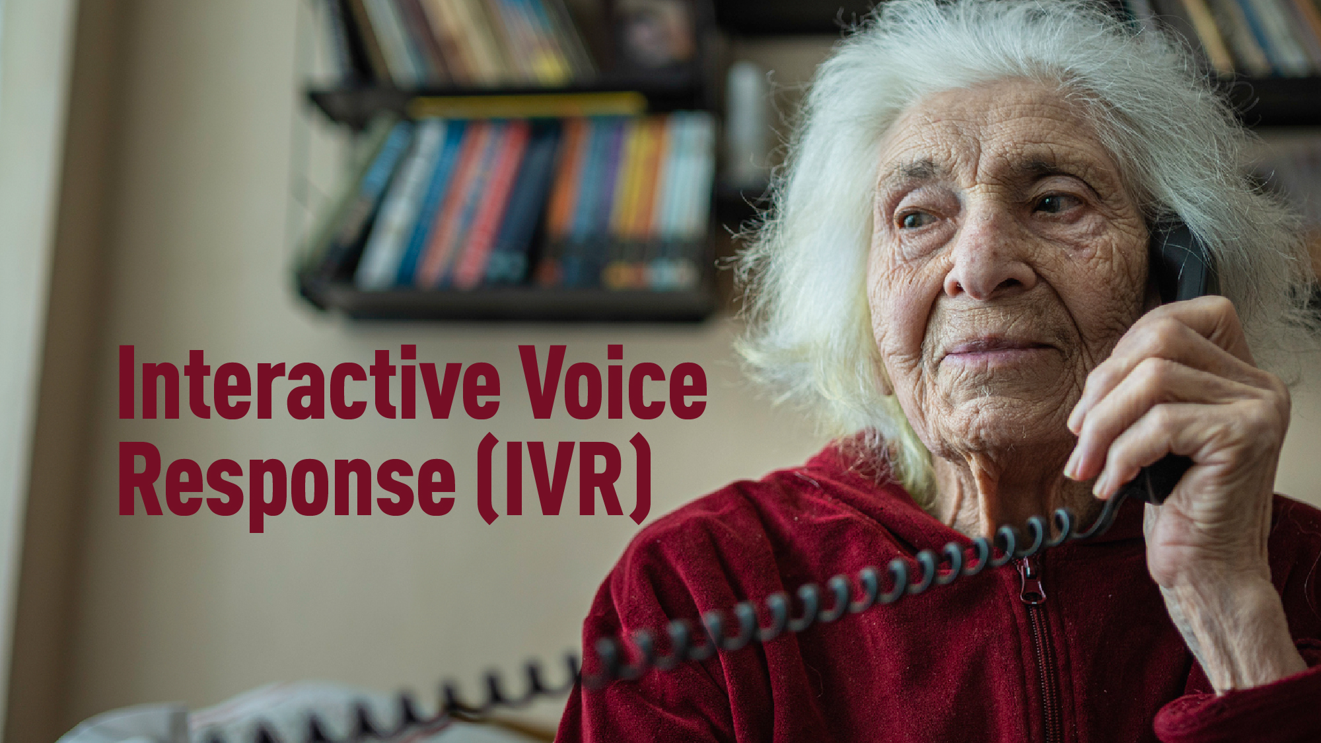
8
Notes:
We understand that not everyone is savvy with technology. So, we also offer the Interactive Voice Response option, or IVR for short, as an alternative to the CareAttend app for live-in attendants to submit their time worked and to document the tasks completed during their shift. The IVR system is another EVV compliant method of time entry. The IVR system will allow attendants to submit time worked to CDCN and Employers to approve by dialing a toll-free number from the member’s registered landline number to start and stop their shifts.

Slide 9
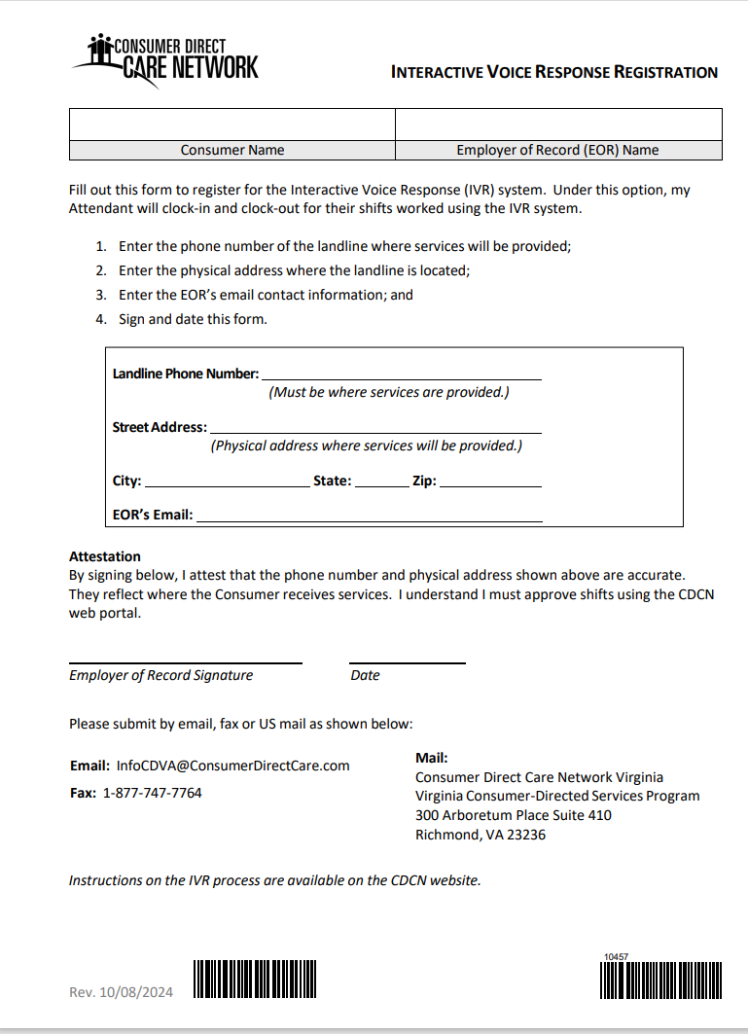
Registration for Interactive Voice Response (IVR)
  New Phone Number: 877.532.8537
  Still need to register?
      Go to website: www.ConsumerDirectVA.com
      Complete and forward the form to us via email: InfoCDVA@ConsumerDirectCare.com or fax: 877.747.7764
9
Notes:
To use the IVR system, the EOR will need to complete a form to register the member’s landline number with CDCN.
A copy of the IVR Registration Form can be found on our website under the Forms menu in the Employer of Record section titled “Additional Materials”. *Go to Website to show where form is*.
Step-by-step time entry approval instructions, and videos can also be found on our website under the Training menu.

Slide 10
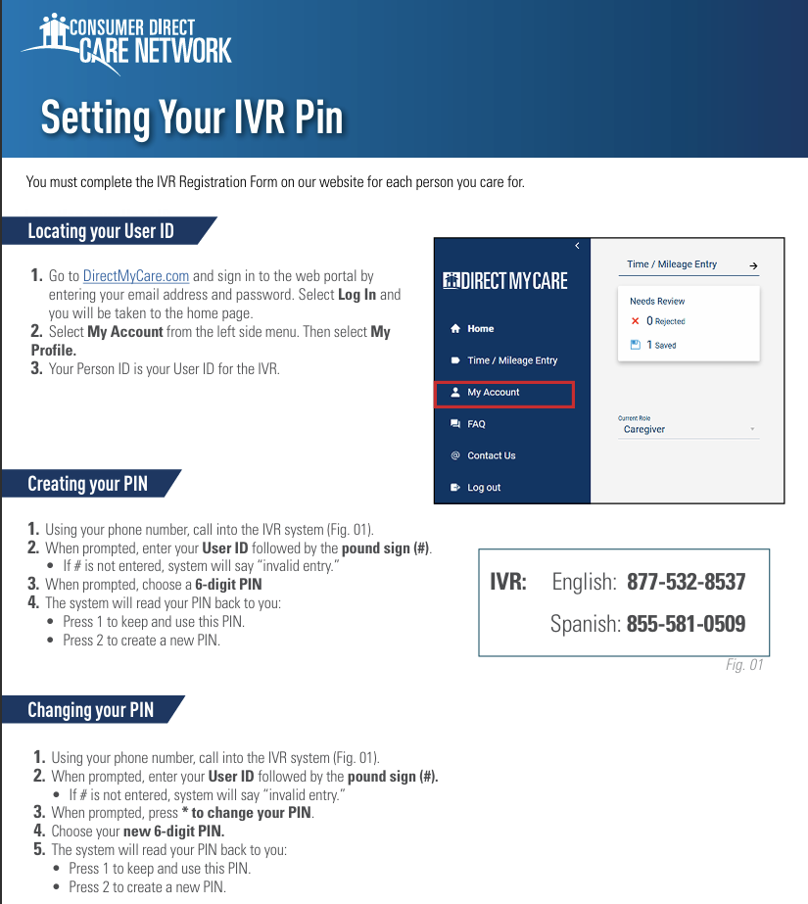
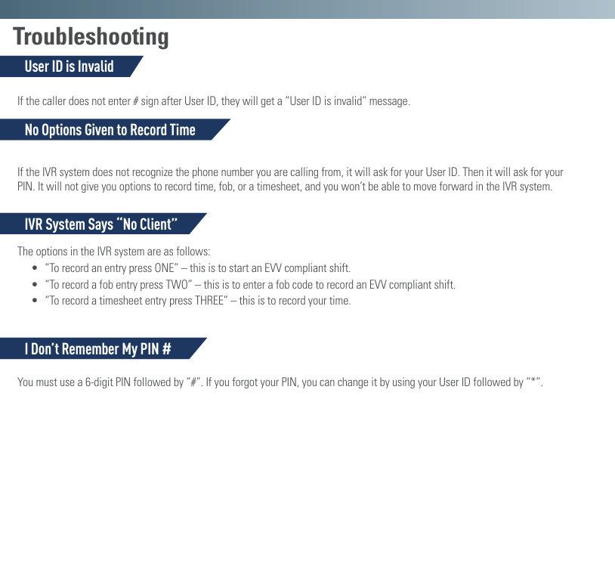
Setting Up Your IVR Pin
Notes:
Before you are able to use IVR, you will need to set up an IVR pin number. The instructions on how to do that are on this form that can also be found on our website under the Training menu in the section titled “CareAttend IVR”.
*Go to Website to show where form is*.
*Pause for questions*

Slide 11
Resources
EVV resources and other helpful materials can be found on our website:
www.ConsumerDirectVA.com
    Training materials, videos, and instructions
    Resources, FAQs, News, 2026 Payroll Calendar
11
Notes:
EVV resources and other helpful material can be found on our website at www.consumerdirectva.com-
The Training Materials, videos, and instructions can be found under the Training menu option.
Resources can be found by selecting the Resources menu option and selecting FAQs.
*Go to website to show where FAQs are located*

Slide 12

Contact Information
Email: InfoCDVA@ConsumerDirectCare.com
Website: www.ConsumerDirectVA.com
Call Center Hours: Monday-Friday 8am-6pm and Saturday 9am-1pm
EVV/IVR: 877.532.8537 (English), 855.581.0509 (Spanish)
Fax: 877.747.7764
Aetna: 888.444.2418
DMAS: 888.444.8182
Humana: 888.444.2717
Sentara Health Plans: 888.444.2419
Kaiser: 888-592-4341
Notes:
If anyone has any questions or concerns in the future, here is a list of our phone numbers and email address to our contact center. Please feel free to reach out to us.

Slide 13
Any Questions?
Notes:
That concludes our presentation for today. If you have any questions right now, you can type them in the chat at this time. I will read and answer them aloud.

